Slide 1

Games Vault Mobile App.

Slide 2
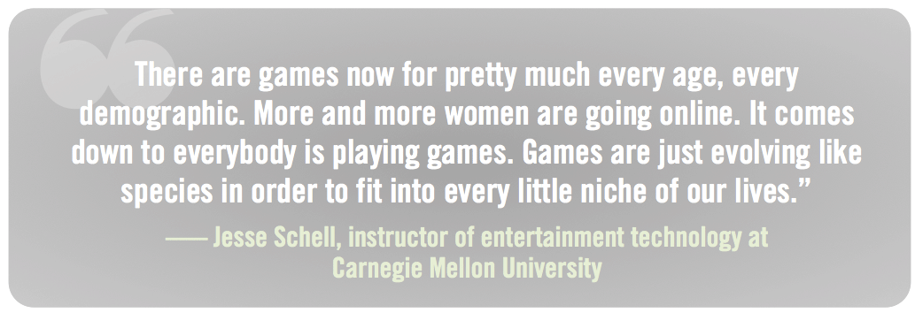

Slide 3
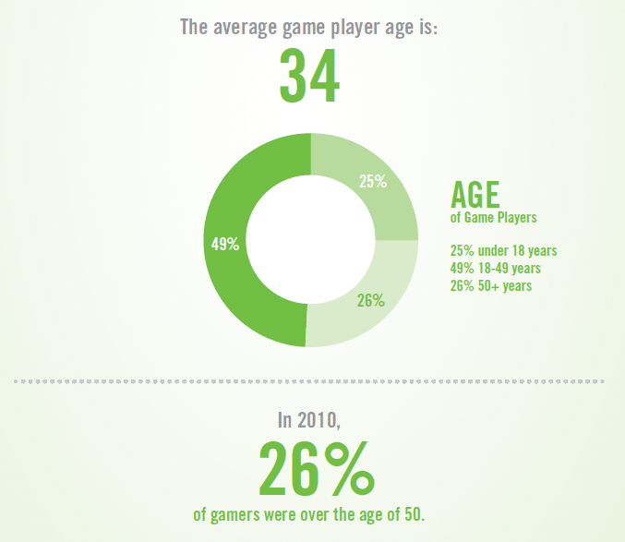
Worldwide over 300 Million People play online games

Slide 4
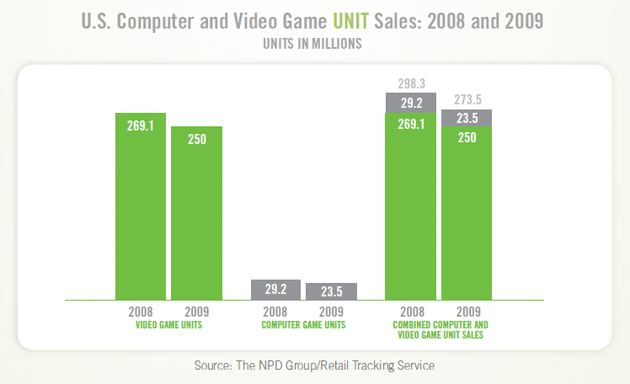

Slide 5
At least 10% out of 300 million people search for further information on internet
To download or read about video games.
Most out of them choose Google as starting point, but that’s not so useful for them because:
There are thousands of website competing with each other on every keyword search
User has to go through multiple website spending a lot of time to look for what
she wants

Slide 6
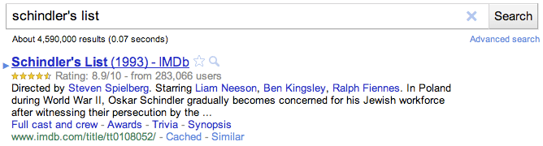
For games there is nothing like IMDB.com is for movies
Example: If searched ‘Shindler’s list’ on Google
A user has the best chance to land on a website where she would find exactly what she is looking for.

Slide 7
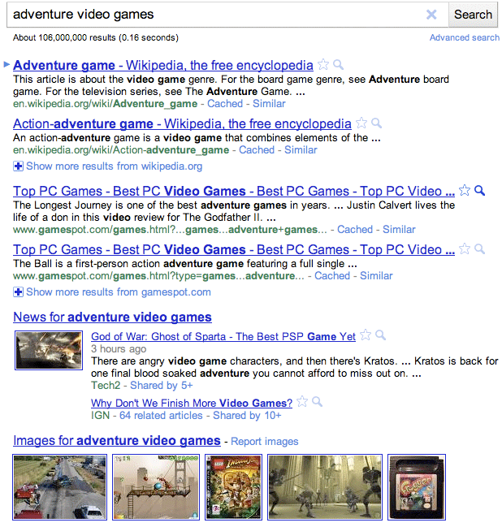
For games there is nothing like IMDB.com is for movies
Example: If searched ‘adventure video games’ on Google
This will hardly help him as quickly as IMDB.com worked for movies.

Slide 8
Games Vault will be like IMDB as a mobile app. For games
There is no such app. Or website exist till now!
Using the information mentioned below, we can design & develop a very simple to user, but powerful User experience.
-Name
-Picture
-Description
-Rating
-Reviews
-Platform availability
-More info @
-Price

Slide 9
There is an API to make it possible
http://api.giantbomb.com/
Giant Bomb is world’s largest video game database, including all sort of data that we will need.
Truth is that even they do not have a app. Out of it so far. And because of too much of competition on keyword search they are not visible to everyone.

Slide 10
Why should we do it?
There are some certain reasons to do it, but hardly none that we should not ☺

Slide 11
What after making the app.
Because there is no such app. Already. We can make it available for download on internet and promote as much as we could.
If possible we can also do a website with more functionality in future.

